Slide 1
Business Income Schedule C
Pub 4012, Tab D
(Federal 1040-Line 12)
(NJ 1040-Line 17)
Notes:
1

Slide 2
Business Income Self Employed - Schedule C
In business for self as a sole proprietor or independent contractor
Trade or business carried on with expectation of making a profit
Must report sales, expenses & net profit on Schedule C
Loss – Out of Scope
A self-employed person performs a service & controls at least one of the following:
Who, What, Where, When & How
Notes:
2

Slide 3
Definitions Related to Schedule C
Business: Continuous & regular activity with income as primary purpose
Employee: Employer controls when, where, & how the employee works
Independent Contractor: Performs services for others
Self-employed for tax purposes
Note: Household employees (baby sitters, cleaning help, home health aides, etc) income is taxable to employee – Out Of Scope for Payer
Notes:
3

Slide 4
Requirements for Business Income to be In Scope
Business expenses of $25,000 or less
Cash method of accounting (not accrual)
No inventory
No net loss from business
Only one sole proprietor business
No employees
No Depreciation/Amortization
No deduction for business use of home (Home Office). This includes the “simplified option for home office deduction”
No prior year disallowed passive activity loss
Notes:
4

Slide 5
Allowable Business Expenses
Pub 4491 Pages D-11
Advertising
Vehicle expenses
Standard mileage only
Commissions
Insurance
Interest
Office & rent expense
Repairs & maintenance
Supplies
Taxes
Travel
Utilities
50% of business meals/entertainment
Professional fees
Notes:
5
Emphasize that if taxpayer claims standard rate for mileage, TS will calculate the expense & include with other business expenses. If taxpayer wishes to claim actual expenses, the return is out of scope

Slide 6
Entering Business Income in TaxSlayer
Pub 4491 Pages D-11
If taxpayer received a 1099-MISC form listing Nonemployee Compensation in Box 7, enter in Federal section \ Income \ Enter Myself \ Form 1099-MISC
After 1099-MISC is entered, TaxSlayer asks if you would like to add the income to a Schedule C for Business Income
If taxpayer does not have a 1099-MISC form, enter business information directly on Schedule C in Federal section \ Income \ Enter Myself \ Profit or Loss From A Business (Schedule C)
Notes:
6

Slide 7
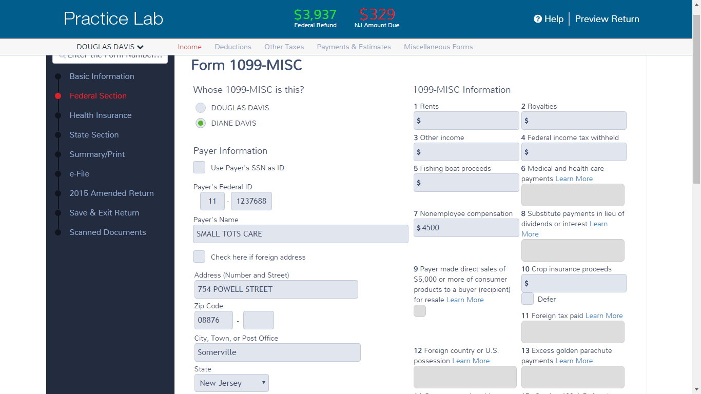
TS - 1099-MISC for Business Income Federal section \ Income \ Enter Myself \ Form 1099-MISC
Nonemployee compensation;
TS transfers to Schedule C
income
Notes:
7

Slide 8
TS - Associate 1099-MISC with Schedule C for Business Income
Pub 4012 Tab D
Notes:
If the income on 1099-MISC is in Box 7 for Nonemployee Compensation, TaxSlayer will associate with Schedule C. If it had been in another box, TaxSlayer would ask if you want to associate with a different place
E.g. - If income in Box 3, TaxSlayer would associate with Line 21 Other Income
8

Slide 9
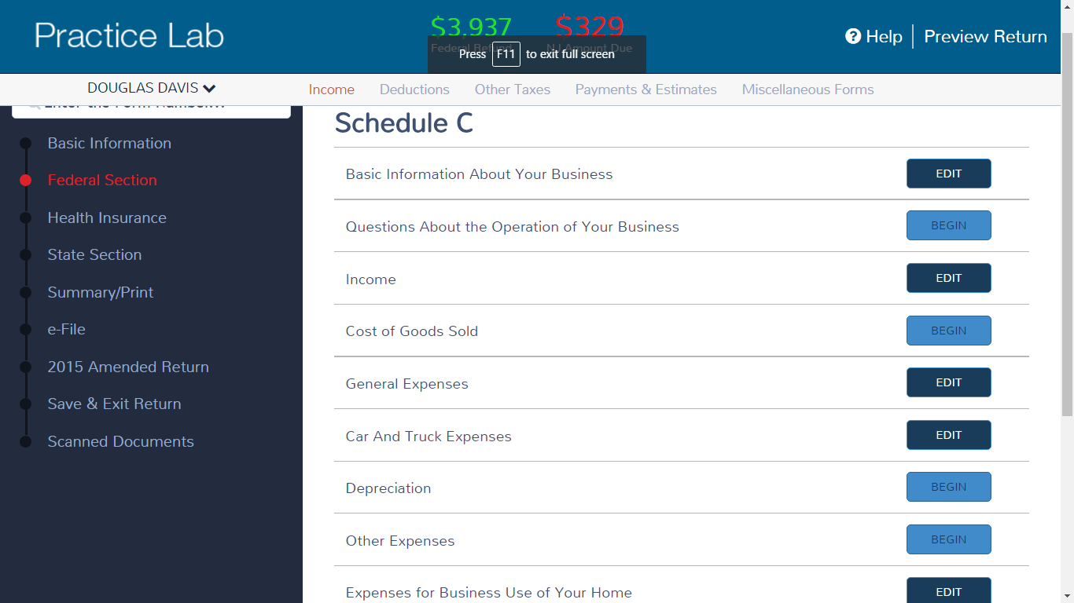
TS – Schedule C Sub-Menu Federal section \ Income \ Enter Myself \ Profit or Loss from a Business (Schedule C)
Pub 4012 Tab D
Complete sections as appropriate
Out of Scope
Notes:
The sections we are most likely to use:
Basic Information About Your Business
Questions About the Operation of Your Business
Income
General Expenses
Car and Truck Expenses
Other Expenses
If client’s situation requires Cost of Goods Sold, Depreciation, or Expenses for Business Use of Your Home section, the return would be Out of Scope
9

Slide 10
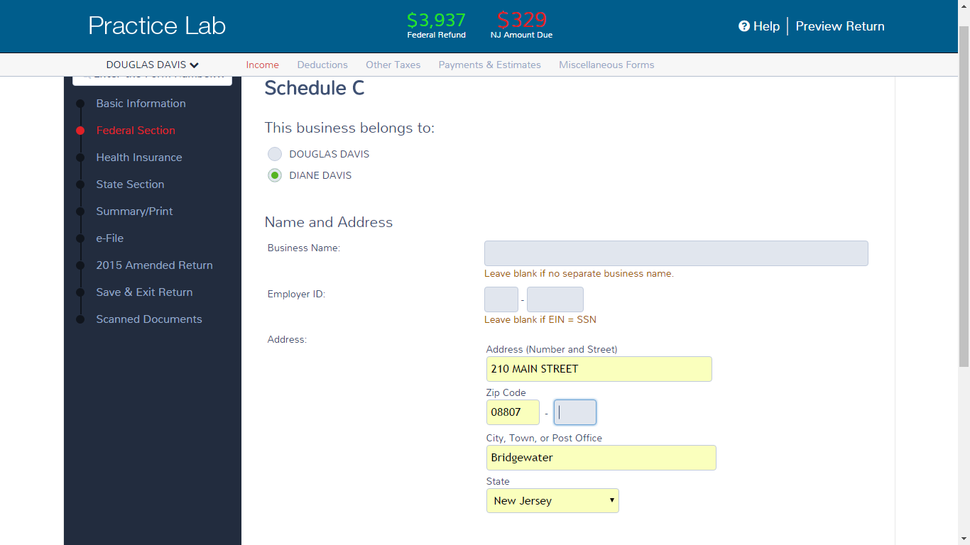
TS – Basic Information About Your Business Federal section \ Income \ Enter Myself \ Profit or Loss From A Business (Schedule C) \ Basic Information about Business
Leave blank if business has no EIN or name
TS populates Business Code you chose
Click here for a list of
Business Codes. Click
on appropriate code
TS populates Description based on business code you chose
Notes:
10

Slide 11
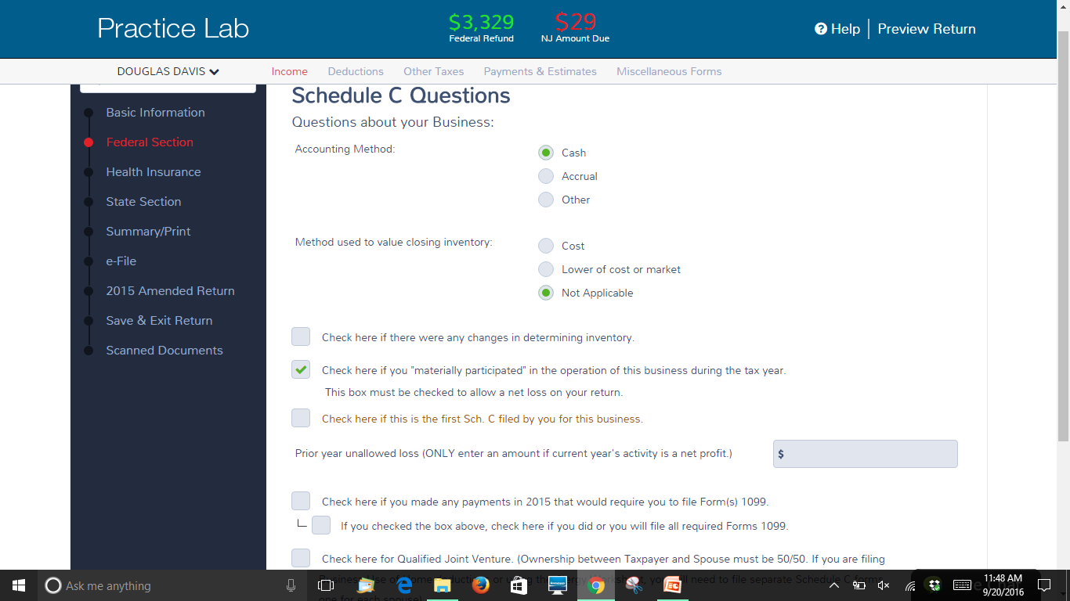
TS – Questions About The Operation of Your Business Federal section \ Income \ Enter Myself \ Form 1099-MISC \ Schedule C \ Questions about Operation of Business
In scope only if cash
In scope only if no inventory
In scope only if materially participated
Started business this year
Out of Scope
Notes:
Answer general information questions about business
Business must use Cash method of accounting to be In Scope
Choose box for Not Applicable for “Method Used to Value Closing Inventory” question, since businesses that have inventory are Out of Scope
Check box for “material participation” question to be In Scope
If you started business in 2015, check box for “This is the first Schedule C filed by your business”
If you made payments that would require use of Form 1099, the return is Out of Scope
11

Slide 12
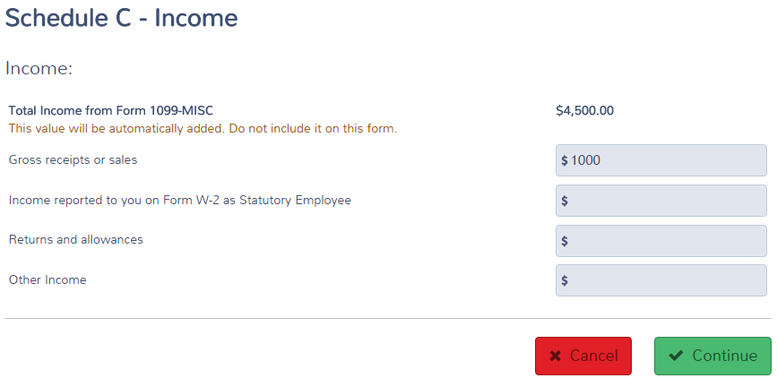
TS – Business Income Federal section \ Income \ Enter Myself \ Form 1099-MISC \ Schedule C \ Income
TS transfers from 1099-MISC screen
Enter if there is income other
than on 1099-MISC
Notes:
12

Slide 13
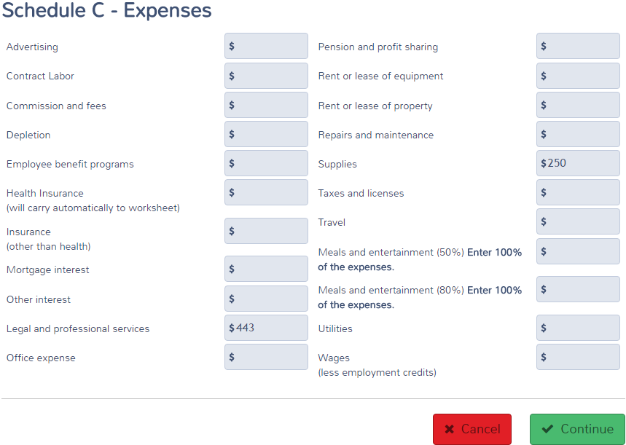
TS – General Expenses Federal section \ Income \ Enter Myself \ Form 1099-MISC \ Schedule C \ General Expenses
TS transfers from 1099-MISC
Enter expenses on appropriate lines
If income other than on 1099-MISC
Notes:
13

Slide 14
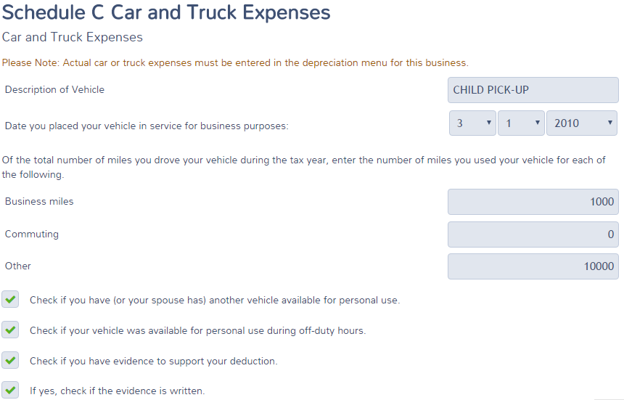
TS – Car and Truck Expenses Federal section \ Income \ Enter Myself \ Form 1099-MISC \ Schedule C \ Car and Truck Expenses
Date car placed in service for business
Enter business, commuting
and other mileage
Check boxes as appropriate; IRS may require
written evidence to support expenses
Notes:
14

Slide 15
TS – Other Expenses Federal section \ Income \ Enter Myself \ Form 1099-MISC \ Schedule C \ Other Expenses
Description of other expenses
Amount of other expenses
Notes:
15

Slide 16
TS - Schedule C Page 1 - Net Profit
TS will calculate Net Profit & transfer to 1040 Line 12
Net profit
NOTE: Out of Scope if net loss
Notes:
TS will calculate Net Profit on Part II Line 31 & transfer to 1040 Page 1 Line 12 Business Income
TS will calculate Self-Employment Tax (Medicare & Social Security) on Schedule SE & transfer result to 1040 Line 57
TS will populate adjustment to income for ½ of Self-Employment Tax on 1040 Line 27
16

Slide 17
TS - 1040 Line 12 – Business Income
TS transfers from Schedule C
Notes:
TaxSlayer transfers the net profit from Schedule C to 1040 Line 12
17

Slide 18
Self-Employment Taxes
If you have Self-Employment income on Schedule C, you must pay Social Security and Medicare taxes on that income
Must have net income from self-employment over $400 to owe self-employment taxes
In 2015, Social Security & Medicare tax rate on self-employment income is 15.3% (12.4 + 2.9)
Same as amount on employees’ wages, which is paid ½ by employer and ½ by employee
Entry on line 1 of Schedule C will cause TS to:
Calculate Self-Employment Tax (Medicare & Social Security) on Schedule SE & transfer result to 1040 Line 57
Record Adjustment to Income for ½ of Self-Employment Tax on 1040 Line 27 (similar to employer amount)
TS computes all automatically
Notes:
18
When a 1099-MISC is received with box 7 filled in (rather than a W-2), it indicates non-employee and must pay self-employment tax if income exceeds $400
TaxSlayer calculates the self-employment tax owed on 1040 Line 57
TaxSlayer calculates the amount that taxpayer can claim as an adjustment to income on Line 27 (one-half the self-employment tax)

Slide 19
TS - 1040 Line 57 – Self-Employment Tax
TS calculates
TS calculates
Notes:
19

Slide 20
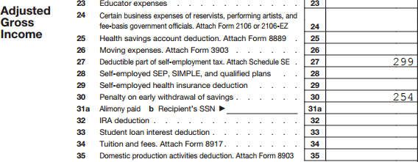
TS - 1040 Line 27 – Deductible Part of Self-Employment Tax
TS calculates
Notes:
20

Slide 21
Schedule C - TS Tips
If business does not have a separate name, leave blank
If business does not have an Employer ID Number (EIN), leave space blank; do not enter SS #
If taxpayer has a 1099-MISC with Box 7 income for nonemployee compensation, enter income on 1099-MISC screen first. Then associate 1099-MISC with Schedule C to enter rest of business information
If taxpayer has no 1099-MISC for nonemployee compensation, enter business income directly on Gross Receipts or Sales line of Schedule C Income screen
Car and truck expenses are entered on a separate screen in TaxSlayer; not included on General Expenses screen
Notes:
21

Slide 22
NJ Bus 1 & NJ Bus 2 Forms
When Schedule C is completed, NJ BUS 1 & 2 will be automatically created in the NJ section
If within scope for Sch C, no action is required on the NJ forms

